Slide 1
Term Project Proposal
Bernardo N. Yahya

Slide 2
Term Project
Proposal Presentation: April 7th, 2016
Contents:
Title : ___________ Analysis System
Expected Data : _________________________
For example, from openAPI, from https://snap.stanford.edu/data/egonets-Facebook.html
Expected Method : _______________________
For example: social network analysis tool
Expected Result:
For example: social network graph

Slide 3
Title: Social Network Analysis System using JSP
Team name: DO IT!
Team member: A, B, C
Expected Data:
circle0 71 215 54 61 298 229 81 253 193 97 264 29 132 110 163 259 183 334 245 222
circle1 173
circle2 155 99 327 140 116 147 144 150 270
circle3 51 83 237
circle4 125 344 295 257 55 122 223 59 268 280 84 156 258 236 250 239 69
circle5 23
circle6 337 289 93 17 111 52 137 343 192 35 326 310 214 32 115 321 209 312 41 20
circle7 225 46
circle8 282
circle9 336 204 74 206 292 146 154 164 279 73
circle10 42 14 216 2
circle11 324 265 54 161 298 76 165 199 203 13 66 113 97 252 313 238 158 240 331 332 134 218 118 235 311 151 308 212 70 211
circle12 278
circle13 138 131 68 143 86
circle14 175 227
circle15 108 208 251 125 325 176 133 276 198 271 288 316 96 246 347 121 7 3 170 323 56 338 23 109 141 67 345 55 114 122

Slide 4
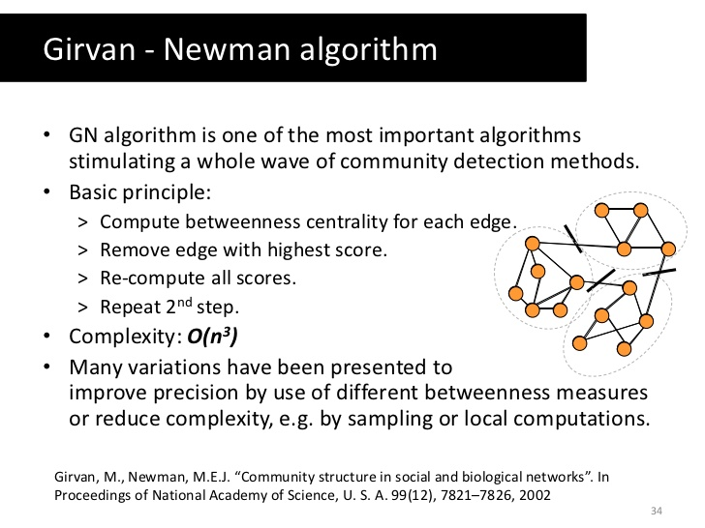
Expected Method

Slide 5
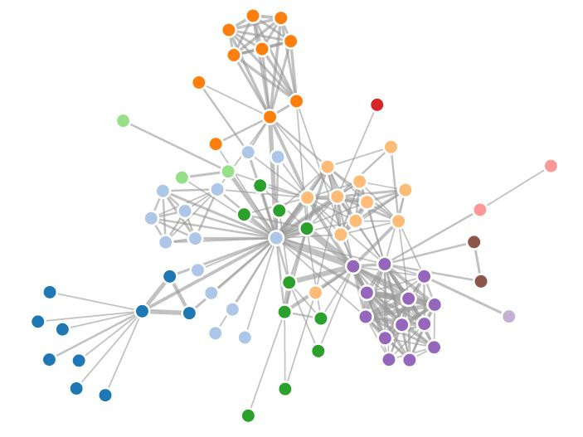
Expected Result
Community-based social network

Slide 6
NOTE
Try to be creative with new tools (or libraries) that exist freely in the internet
http://www.creativebloq.com/design-tools/data-visualization-712402
Start from NOW !

